Slide 1
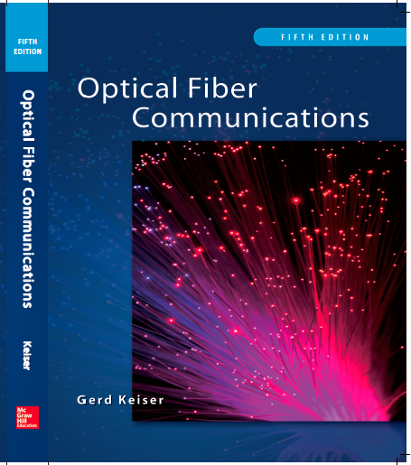
Gerd Keiser, Optical Fiber Communications,
McGraw-Hill, 5th International Edition, 2015
Lecture Notes for Chapter 1 Overview

Slide 2
Overview – Chapter 1
1.1 Motivations for Lightwave Communications
1.2 Optical Spectral Bands
1.3 Decibel Units
1.4 Network Information Rates
1.5 Optical Channel Multiplexing
1.6 Key Elements of Optical Fiber Systems
1.7 Evolution in Optical Communication Networks
1.8 Standards for Optical Fiber Communications
1.9 Modeling and Simulation Tools

Slide 3
1.1 Motivations (1)
Lifestyle changes from Internet growth and use
  Average phone call lasts 3 minutes
  Average Internet session is 20 minutes
More and more bandwidth-hungry services are appearing
  Web searching, home shopping, high-definition interactive video, remote education, telemedicine and e-health, high-resolution editing of home videos, blogging, and large-scale high-capacity e-science and Grid computing
Increase in PC storage capacity and processing power
  20G hard drives were fine around 2000; now standard is 160G
  Laptops ran at 300 MHz; now the speed is over 3 GHz
There is an extremely large choice of remotely accessible programs and information databases

Slide 4
1.1 Motivations (2)
Advantages of optical fibers
Long Distance Transmission: The lower transmission losses in fibers compared to copper wires allow data to be sent over longer distances.
Large Information Capacity: Fibers have wider bandwidths than copper wires, so that more information can be sent over a single physical line.
Small Size and Low Weight: The low weight and the small dimensions of fibers offer a distinct advantage over heavy, bulky wire cables in crowded underground city ducts or in ceiling-mounted cable trays.
Immunity to Electrical Interference: The dielectric nature of optical fibers makes them immune to the electromagnetic interference effects.
Enhanced Safety: Optical fibers do not have the problems of ground loops, sparks, and potentially high voltages inherent in copper lines.
Increased Signal Security: An optical signal is well-confined within the fiber and an opaque coating around the fiber absorbs any signal emissions.

Slide 5
1.2 Optical Spectral Bands (1)
O-Band
E-Band
S-Band
C-Band
L-Band
U-Band
1260
1360
1460
1530
1565
1625
1675
Wavelength (nm)
    Original band (O-band): 1260 to 1360 nm
      Region originally used for first single-mode fibers
    Extended band (E-band): 1360 to 1460 nm
      Operation extends into the high-loss water-peak region
    Short band (S-band): 1460 to 1530 nm (shorter than C-band)
    Conventional band (C-band): 1530 to 1565 nm (EDFA region)
    Long band (L-band): 1565 to 1625 nm (longer than C-band)
    Ultra-long band (U-band): 1625 to 1675 nm

Slide 6
1.2 Optical Spectral Bands (2)
Optical communication uses wavelength to designate the spectral operating region and photon energy or optical power when discussing topics such as signal strength or electro-optical component performance.
In a vacuum the speed of light c is equal to the wavelength λ times the frequency ν, so that
c = λ ν
The relationship between the energy of a photon and its frequency (or wavelength) is determined by Planck’s Law
E = h ν
where h = 6.63 × 10^{–34} J-s = 4.14 × 10^{–15} eV-s is Planck’s constant.
In terms of wavelength (measured in units of μm), the energy in electron volts is given by
E(eV) = 1.2406/λ(μm)

Slide 7

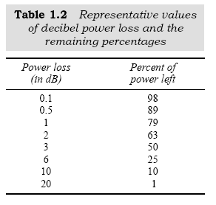

1.3 Decibel Units (1)
The decibel (dB) unit is defined by

Slide 8

1.3 Decibel Units (2)
Since the decibel is used to refer to ratios or relative units, it gives no indication of the absolute power level.
A derived unit called the dBm can be used for this purpose.
This unit expresses the power level P as a logarithmic ratio of P referred to 1 mW.
The power in dBm is an absolute value defined by

Slide 9
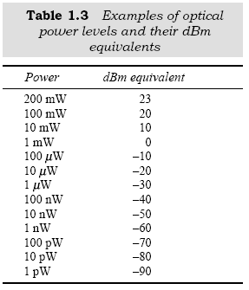
1.3 Decibel Units (3)
A rule-of-thumb relationship to remember for optical fiber communications is 0 dBm = 1 mW.
Therefore, positive values of dBm are greater than 1 mW and negative values are less than 1 mW.

Slide 10
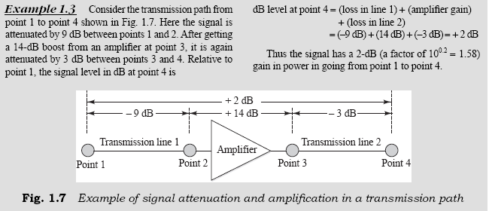
1.3 Decibel Units (4)
Power levels differing by many orders of magnitude can be compared easily when they are in decibel form.

Slide 11
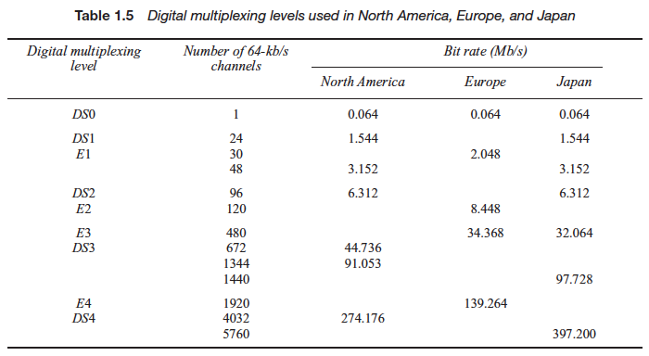
1.4 Network Information Rates (1)

Slide 12
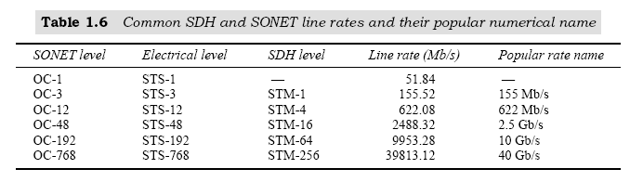
1.4 Network Information Rates (2)
A standard signal format called synchronous optical network (SONET) is used in North America
A standard signal format called synchronous digital hierarchy (SDH) is used in other parts of the world

Slide 13
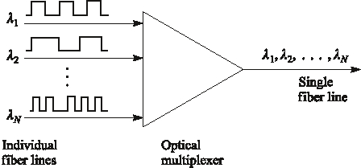
1.5 WDM Concepts
Many independent information-bearing signals are sent along a fiber simultaneously
Independent signals are carried on different wavelengths
Data rates or formats on each wavelength may be different
Coarse WDM (CWDM) and dense WDM (DWDM) are the two major wavelength multiplexing techniques
Wavelength routing and switching techniques based on lightpaths are being developed

Slide 14
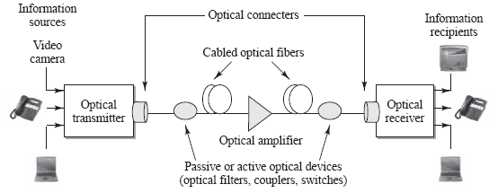
1.6 Key Elements of Optical Fiber Systems
Transmitter: a light source and signal-formatting circuitry
A cable offering mechanical and environmental protection to the optical fibers contained inside
A receiver consisting of a photodetector plus amplification and signal-restoring circuitry
Other components: Optical amplifiers, connectors, splices, couplers, regenerators, and passive and active devices.

Slide 15
1.7 Standards
The three basic classes for fiber optics are primary standards, component testing standards, and system standards.
Primary standards deal with physical parameters: attenuation, bandwidth, operational characteristics of fibers, and optical power levels and spectral widths.
Component testing standards define tests for fiber-optic component performance and establish equipment-calibration procedures.
  The main ones are Fiber Optic Test Procedures (FOTP)
System standards refer to measurement methods for optical links and networks.

Slide 16
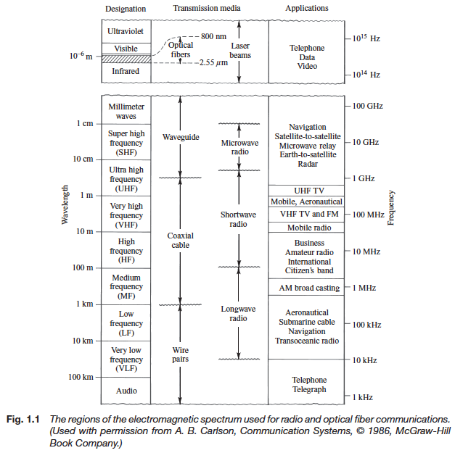
Figure 1.1

Slide 17
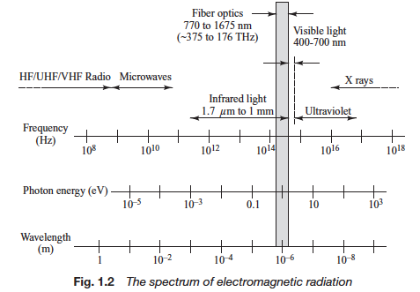
Figure 1.2

Slide 18
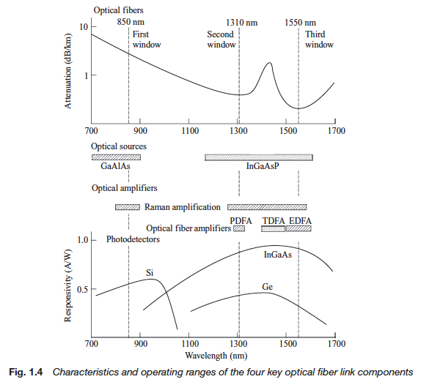
Figure 1.4

Slide 19
The attenuation history is given in the following Figure
Initially in early 1970s due to technology limitation, the optical fiber had a low loss window around 800nm. Also the semiconductor optical sources were made of GaAs which emitted light at 800nm. Due to compatibility of the medium properties and the sources, the optical communication started in 800nm band so called the ‘First window' .
As the glass purification technology improved, the true silica loss profile emerged in 1980s. The loss profile shows two low loss windows, one around 1300nm and other around 1550nm. In 1980s the optical communication shifted to 1300nm band , so called the ‘ Second Window' . This window is attractive as it can support the highest data rate due to lowest dispersion.
In 1990s the communication was shifted to 1550nm window, so called ‘Third Window‘ due to invention of the Erbium Doped Fiber Amplifier (EDFA). The EDFA can amplify light only in a narrow band around 1550nm. Also this window has intrinsically lowest loss of about 0.2 dB/Km . This band has higher dispersion, meaning lower bandwidth. However, this problem has been solved by use of so called ‘dispersion shifted fibers'.

Slide 20
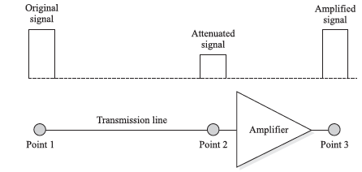
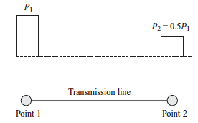
Figures 1.5 and 1.6

Slide 21
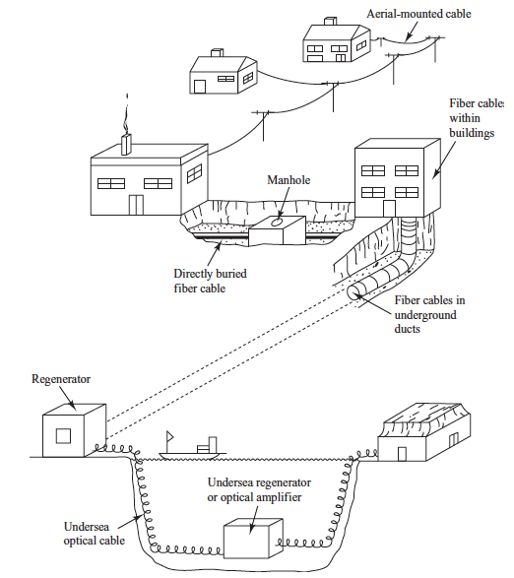
Figure 1.11

Slide 22
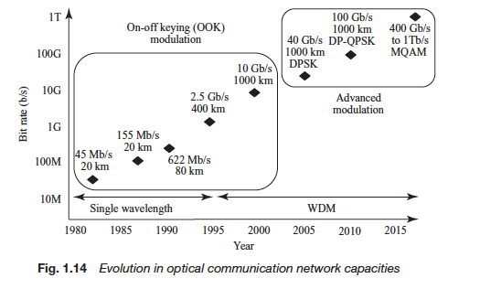
Figure 1.14

Slide 23
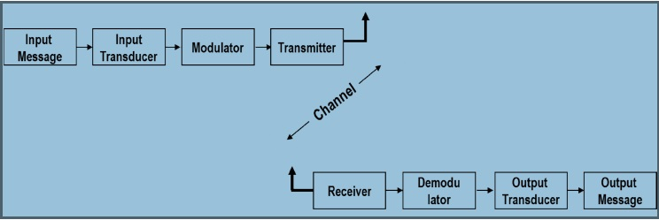
Basic Elements of communication System

Slide 24
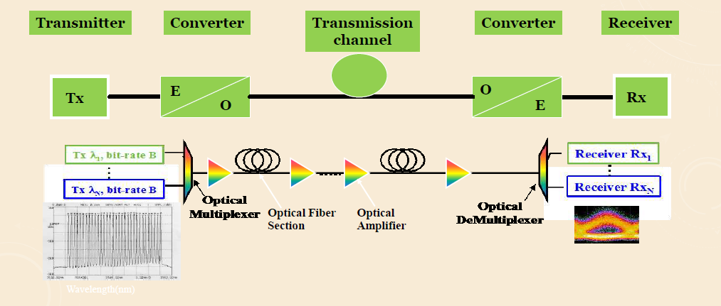
Optical Communication System

Slide 25
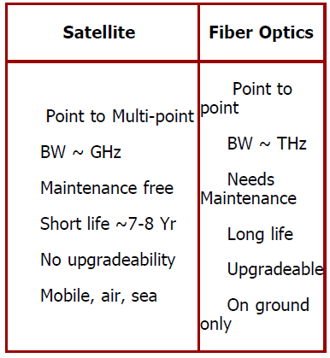
Comparison of Satellite and Optical communication

Slide 26
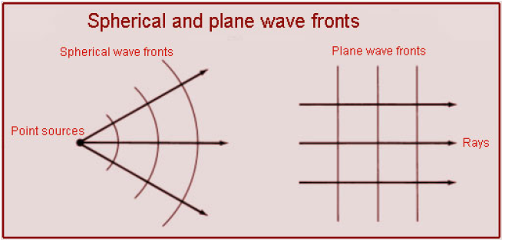
Spherical and Plane Wave Fronts
Light is an Electromagnetic wave.
It consists wave fronts. The lines normal to the wave fronts are called the light rays.
If the phase fronts are concentric spheres, the light is called a spherical wave, and if the phase fronts are parallel planes, the light is called a plane wave.

Slide 27
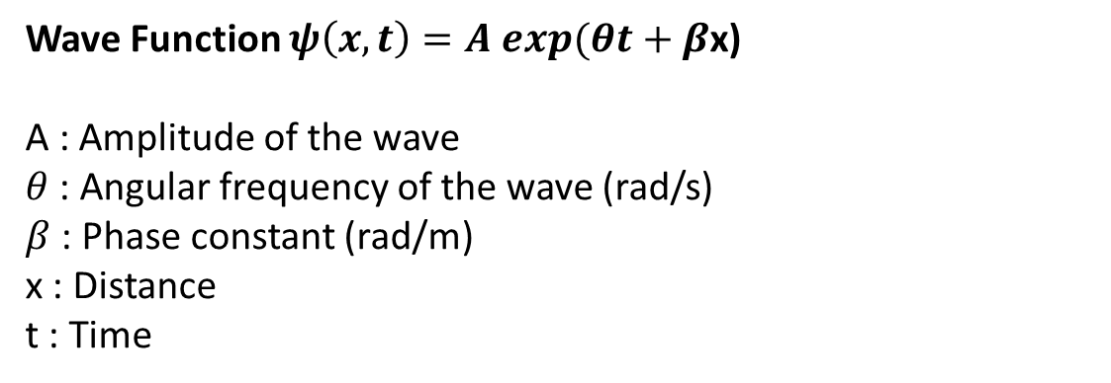
For a plane waves the rays are parallel whereas for the spherical wave, the emerge from the center of the spheres.
If the source is a finite distance, the appropriate model is the spherical wave model, and if the source is assumed to be at infinite distance, the plane wave model is appropriate.
A plane wave can be represented by a wave function which is a composite function of space and time

Slide 28
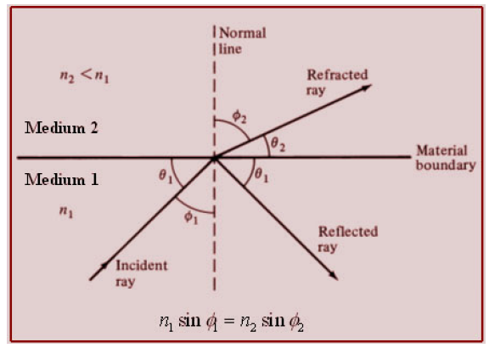

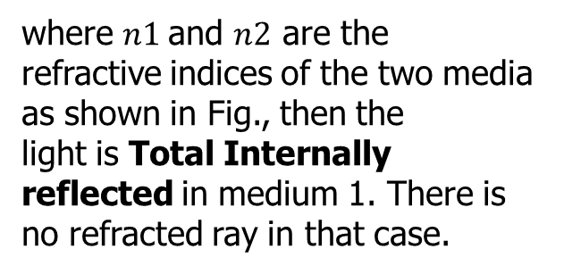
Snell's Law
When light travels from one medium to other, it gets refracted. The relation between the angle of incidence and the angle of refraction is given by the Snell's law. The Snell's law is described in the following figure.
If the angle of incidence, is greater than the critical angle, given by

Slide 29


